Slide 1
Candyspace - CMS Developer Test
Digital Collections in CMS (Sitecore)
https://github.com/Miser-A/CandyspaceCMS
John Vincent Armamento
03/03/2025

Slide 2
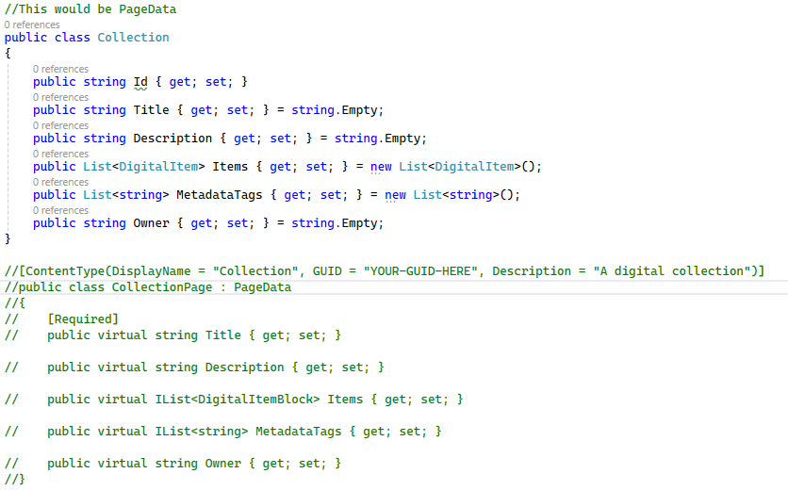
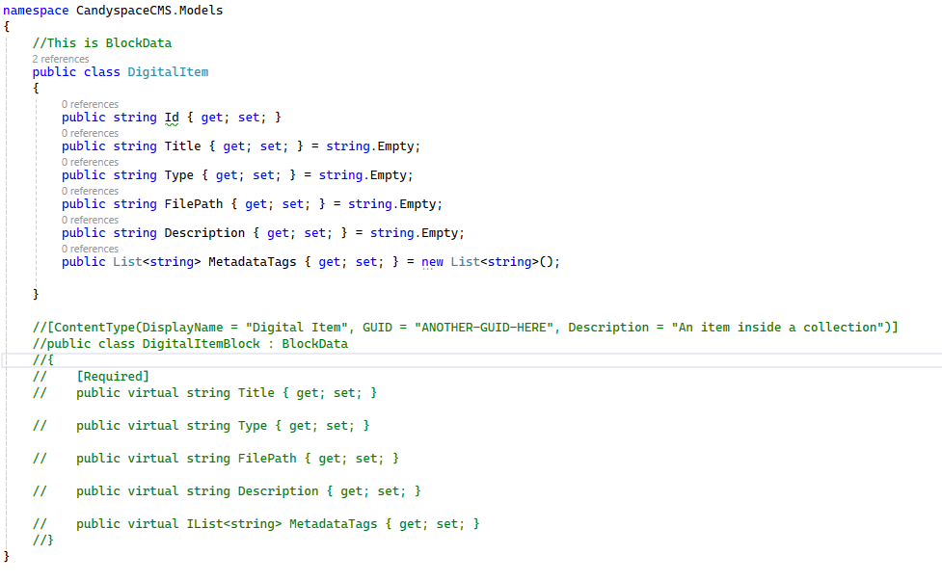
Content Modeling
In my research on Optimizely, the equivalent of Sitecore templates would be PageData and BlockData. In this case, I created a Collection and Digital Item Model, the CollectionPage (PageData) acts as the parent container, while individual DigitalItemBlocks (BlockData) represent the items within the collection. This mirrors how Sitecore uses templates to structure content hierarchies, ensuring a flexible and scalable content model.

Slide 3
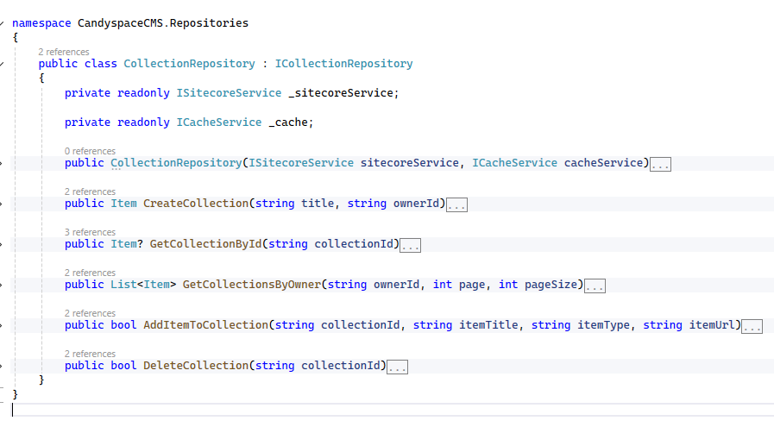
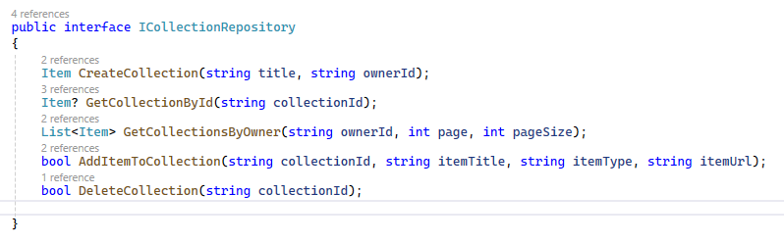
Data Storage & Retrieval
I stored and retrieved collection data using Sitecore’s content tree through the ISitecoreService. This allowed us to manage collections and their items as structured CMS entities instead of traditional database records. The repository pattern (CollectionRepository) was implemented to abstract Sitecore’s API, ensuring clean separation between data access and business logic. Similar to how Sitecore and Optimizely allow content retrieval via APIs or structured storage mechanisms, this approach leverages the CMS’s built-in hierarchy for efficient content management.

Slide 4
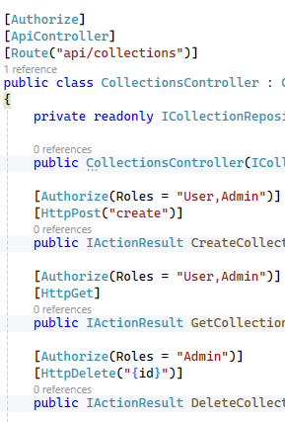
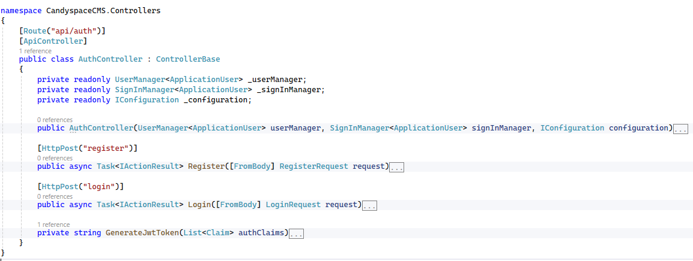
Security & permissions
I implemented JWT-based authentication with role-based access control (Admin, User) to manage access to collections. Authentication is handled via ASP.NET Identity with hashed passwords, ensuring secure login and registration.

Slide 5
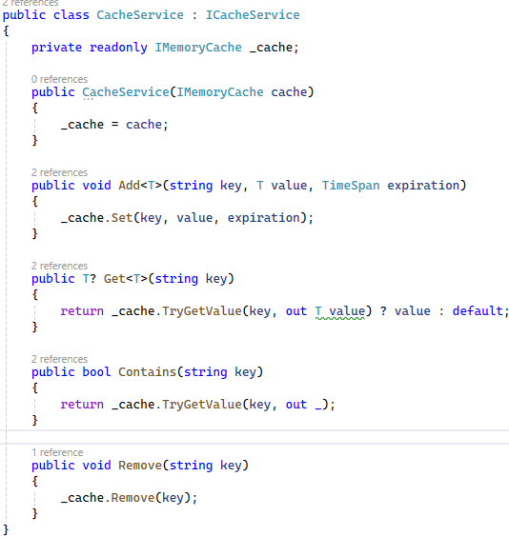
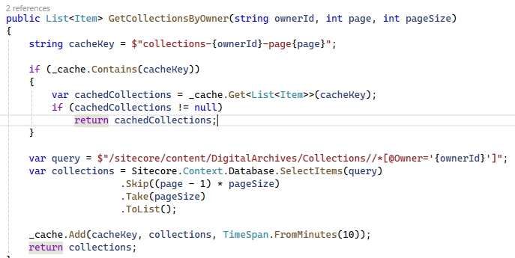
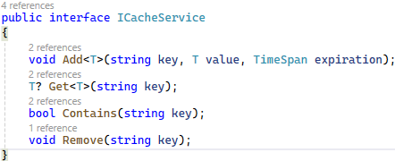
Performance Considerations
To optimize performance when handling large collections, I implemented pagination to load only a subset of data at a time, which helps reduce memory usage and improve response speed. I also introduced caching via ICacheService to store frequently accessed collections for 10 minutes, minimizing redundant queries. Additionally, I optimized queries by filtering collections efficiently. These strategies ensure efficient data retrieval, similar to how Sitecore and Optimizely optimize content retrieval via indexing and caching.

Slide 6
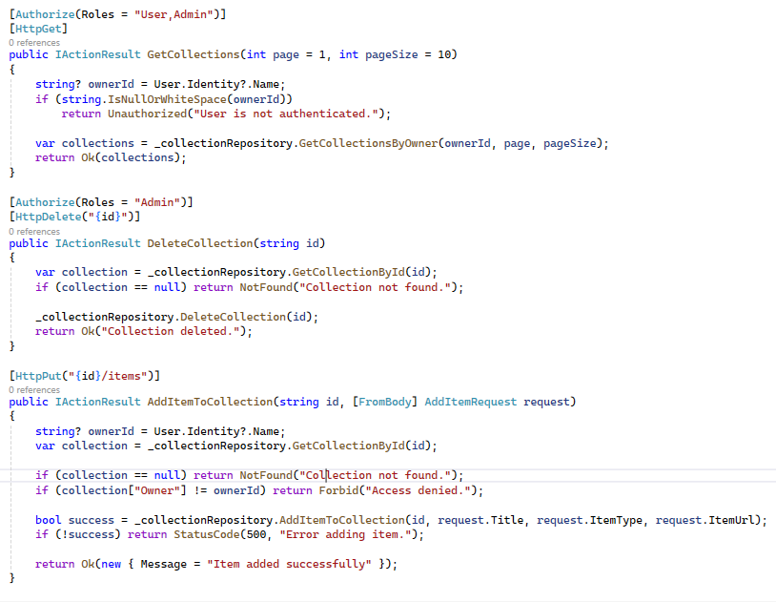
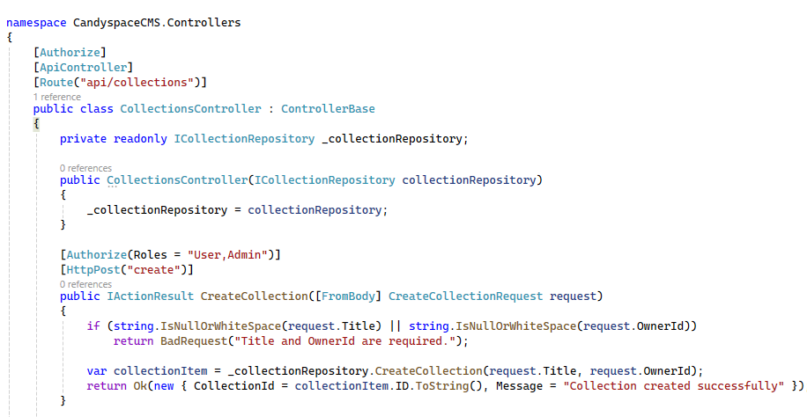
API
I created a basic API to manage digital collections using the CMS by designing a set of endpoints that allow users to create, retrieve, and update collections. I structured the API to follow RESTful principles, with endpoints for creating new collections, adding items, and retrieving user-specific collections. I used a repository pattern to interact with the CMS, ensuring clean separation between the API logic and data handling.

Slide 7
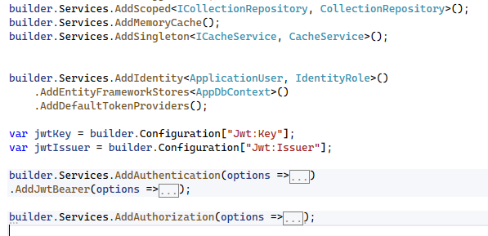
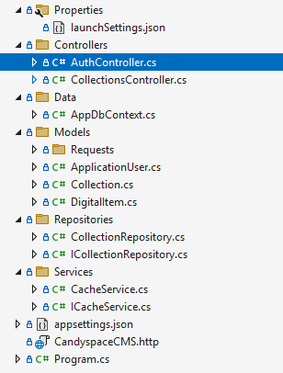
Coding Practices
In structuring the code, I implemented a repository pattern to separate database logic from the API controllers, making the code modular and testable. Dependency injection was used for services like authentication, caching, and data access, promoting a clean architecture. Additionally, validation and error handling were integrated into the API endpoints to improve reliability. The API follows RESTful principles, ensuring clear and consistent resource management. This approach not only aligns with industry standards but also makes the system adaptable to future enhancements.

